Slide 1



Challenges and Advances in Constructing Arabic Dialect Corpora and Linguistic Tools for the Moroccan Dialect
Nadia khlif
nadia.khlif@ilc.cnr.it
AIUCD2024
07/05/2024
Notes:
Good evening, everyone. I'm Nadia Khlif, a PhD student specializing in Natural Language Processing, currently based in Morocco. Additionally, I'm a researcher at CNR-ILC in Pisa, Italy, where I contribute to the CWALM project (A Lexical Corpus-based Model of Contemporary Written Arabic).
I’m excited to have this opportunity to share our work on the Challenges and Advances in Constructing Arabic Dialect Corpora and Linguistic Tools for the Moroccan Dialect.

Slide 2

Introduction
Arabic language & Darija Dialect
Results & discussion
DiMorph
Challenge’s Darija
Linguistic features
Conclusions & Perspectives
PLAN
Notes:
Let's break down the presentation plan.
We'll begin with an introduction,
followed by a discussion on the differences between the Arabic language and the specific dialect known as Darija, which is specific to Morocco.
Afterward, we'll delve into the linguistic features of Darija and explore the challenges associated with it.
Next, we'll introduce DiMorph, the tools designed for analyzing Darija.
We'll then discuss the results obtained from using this tools.
Finally, we'll conclude by summarizing our findings and discussing future perspectives.

Slide 3






Introduction
Data Collection
Step1:
Collection of a Representative Corpus: establish a genuinely representative corpus of Colloquial Arabic Varieties.
Tools: DiMorph
Step2:
Tools Adaptation: enhance linguistic annotations within our corpora through the adaptation of the morphological Analyzer Aramorph for processing written dialectal words.
Manual disambiguation of a Subcorpus
Step3:
Corpus Annotation: manual disambiguation of a subcorpus collected and analyzed to adapt methodologies in deep learning for the Automatic Annotation of the Entire corpus.
Lexical Model
Step4:
Developing a Lexical Model: Bridging Corpus Data and Existing Lexical Sources.
3
Notes:
In the introduction, we'll outline the structure of the project, which is based on four main phases.
The first one is to collect a representative corpus.
The second step is to adapt a tool for processing dialectal words; for this purpose, we chose AraMorph.
The third step is to extract a sub-corpus collected and analyzed to manually disambiguate.
The last step is to construct a robust lexical model.

Slide 4
Arabic Language & Darija dialect
Classical Arabic
The Language of the Quran.
Modern Standard Arabic (MSA)
Foundation in Classical Arabic.
Arabic Dialects
Localization and Informality.
Adherence to Strict Grammatical Rules.
Religious Significance and Unique Dictionary.
Linguistic Authorities and Standardization.
Uniformity in Written Communication.
Organic Evolution within Communities.
Lacks of the formal recognition and standardized grammar rules.
4
Notes:
Concerning the Arabic language,
We have Classical Arabic, known as the language of the Quran, with strict grammar rules and its own dictionary due to its religious importance.
Next is Modern Standard Arabic (MSA), based on Classical Arabic, regulated by linguistic authorities for consistency in written communication across Arab countries. Arabic dialects are spoken languages specific to certain areas, without official recognition or standardized rules like MSA. They evolve naturally within communities, reflecting unique linguistic traits shaped by local culture and history.

Slide 5

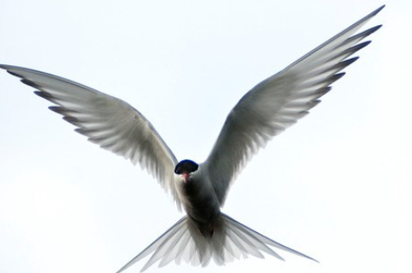
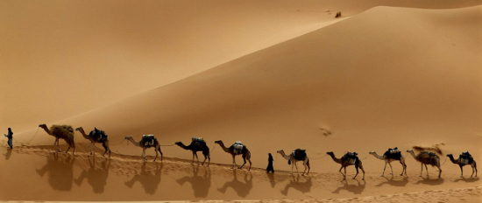
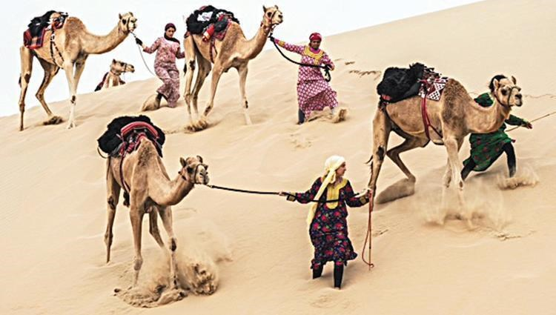



Arabic Language & Darija dialect
Arabic Classic
/kataba/ كتب
/ʈˁayɂir/طائر
/qiʈˁar/قطار
/sayaːrat/سيارة
Write
Bird
Walking in sequence
Walking in different way
Word Time Shifts
MSA
/ ʈˁayɂirt / طائرة
/kataba/ كتب
/qiʈˁar/قطار
/sayaːrat/سيارة
Write
Plane
Train
Car
Darija
/kotabo/ كتب
/ ʈˁayaːr /طيار
/toraːn/ تران
/ʈˁuːmuːbiːɫ/ طوموبيل
Write
Plane
Train
Car
Variant phonetic
Lexical borrowing
5
Notes:
The following slide presents some special examples.
The first one is the word 'write.' There is no change during the transition from Classical Arabic to MSA, but in Darija, there is a change in vocalization its become.
For the second word, 'bird,' there is a time shift in MSA, representing the plane. In Darija, it remains the same, with only changes in spelling of the word.
These two examples illustrate a phenomenon called variant phonetics. For the word 'qitar,' which means 'walking in sequence' in Classical Arabic, as depicted by a photo showing a group of camels walking in order, it translates to 'train' in MSA. However, in Darija, while it retains the same meaning, it is represented by a different token derived from a French word.
Similarly, the word 'sayara,' which means 'walking in different ways' in Classical Arabic, refers to vehicles, specifically 'cars,' in MSA. In Darija, it holds the same meaning as in MSA, but it is transliterated from a French word.
In this instance, we observe a phenomenon called lexical borrowing.

Slide 6
Arabic Language & Darija dialect
Article de reference:
Tachicart, Ridouane, Karim Bouzoubaa, and Hamid Jaafar. 2016. “Lexical differences and similarities between moroccan dialect and Arabic”.
6
Notes:
Darija has its roots in Modern Standard Arabic (MSA), making up about 80% of its vocabulary.
But it's not just Arabic; it also includes words from other languages.
For example, Tamazight, the Berber language, makes up around 4% of Darija's words.
Plus, because of Morocco's history, French has influenced about 11% of Darija's vocabulary, while Spanish contributes to roughly 5%. These stats presented are retrieved from the article.

Slide 7
Linguistic features
Surface realisation
The morpho-syntactic layer combines the inflected form with clitics (prepositions, conjunctions, definite articles, etc.) to shape a rich and complex surface form.
Alteration Rules
Clitics
Verbal Inflected Form
Nominal Inflected Form
The inflectional layer is the one where the lemma combines with inflectional affixes to give inflectional forms.
Alteration Rules
Inflection Affixes
Verbal Lemma
Nominal Lemma
The derivation layer is the deepest one. At this level, the root combines with the vowels, according to determined patterns, to produce a verbal or a nominal lemma.
Alteration Rules
Pattern
Root
Vocalic
7
Notes:
When exploring linguistic features,
we'll delve into the morphological structure,
which consists of three main levels.
First, there's the derivation layer,
followed by the inflectional layer,
and finally, the morpho-syntactic layer.

Slide 8
Surface realisation
Alteration Rules
Clitics
Verbal Inflected Form
Nominal Inflected Form
Alteration Rules
Inflection Affixes
Verbal Lemma
Nominal Lemma
Alteration Rules
Pattern
Root
Vocalic

Slide 9
Linguistic features
Example of Agglutinative aspects
w=katb+at=hu
and she writes it
conj
write.PV
3SP
w
katb+at
hu
Example of Grammatical Aspects
w=ma= katb+at=u:=ʃ
And we didn’t write it
conj = NEG
write.PV
3SP = NEG
w
ma
katb+at
uː
ʃ
8
Notes:
Let’s visualize this with the following examples
For the Agglutinative aspects
The red equals sign is an agglutinative marker. We divide the token into three parts: the conjunction particle, the perfect verb, and its conjugation to the third singular person.
For grammatical aspects, the token is sub-tokenized as follows: the conjunction particle with the negation prefix, the perfect verb, and its conjugation to the third singular person with the negation enclitic. .

Slide 10
Linguistic features
In the two examples, the inflected form is surrounded by clitics and the morphological structure is:
Proclitics
Prefix
Stem
Suffixes
Enclitics
By removing clitics, the remaining word form is a minimally autonomous inflected form whose structure consists of:
Prefix
Stem
Suffixes
9
Notes:
Is the following
By removing clitics the minimally inflected form is this one

Slide 11




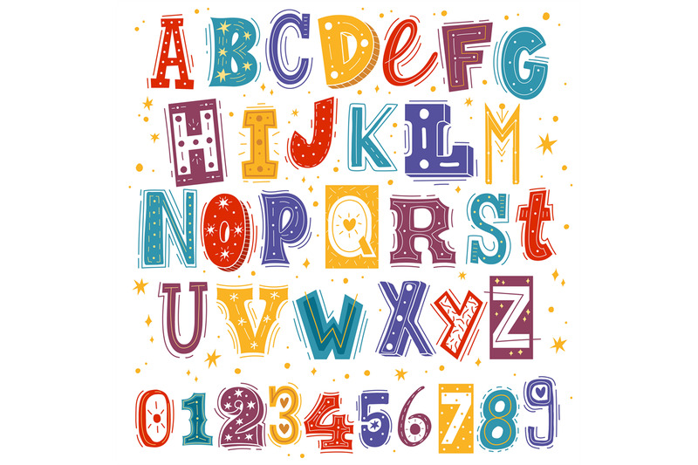
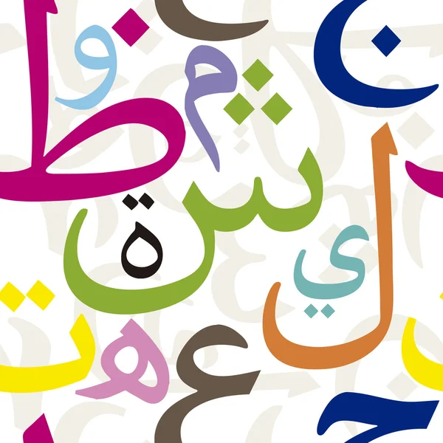
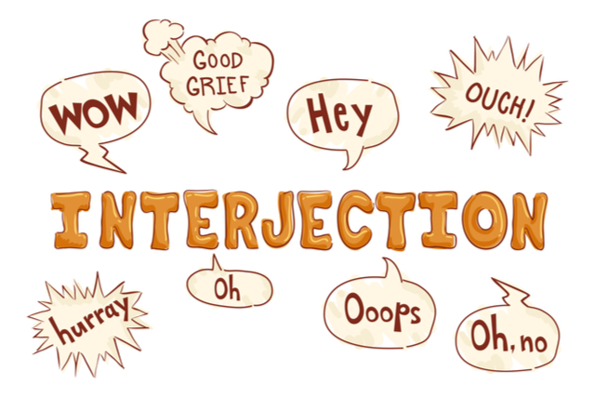
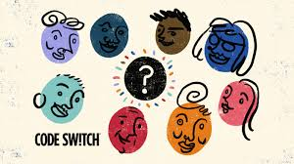
Challenge’s Darija
Poor resources
Challenges
Issues of Texts retrieved from social platforms
Inherent characteristic’s Daija
10
Notes:
Challenges in working with Darija include limited linguistic resources, particularly linguistic data and annotated corpora.
Additionally, texts sourced from social media platforms present issues such as noise, informal language, and non-standardized spelling, posing challenges for data preprocessing and analysis. Moreover, the inherent characteristics of Darija, including code-switching between Arabic and other languages like French and Spanish, add complexity to linguistic processing tasks.

Slide 12
Challenge’s Darija
Examples :
 | Phenomenon | Examples | English
Script mixing | Is a mixing letter between Arabic and Latin | الg قال /qaːl/ | ‘say’
Code switching | Is a switching between Moroccan dialect and French words ‘les valises’. | كنخوي لي فاليز /kanaxuːiː liː faːliːz/ | ‘I unload the luggage’
Code mixing | Is a French word ‘La valise’ with MSA enclitic ‘ال’ and feminine suffix ‘ة’. | الفاليزة /aː=lfaːliːz-t/ | ‘The luggage’
11
Notes:
The following table presents some examples:
For script mixing, the phenomenon is...
In the case of code-switching, we observe a switching...
As for code-mixing, we have the example that is...

Slide 13
DiMorph
Input: Text
Preprocessing
Processing
Darija Resources
Found
NO
Postprocessing
YES
Output: Each Token Receives Vocalization, POS Tagging, English Gloss
12
Notes:
The following schema presents the workflow of DiMorph,
a morphological analyzer based on AraMorph. It translates Arabic text using Buckwalter’s transliteration system.
Consist of three main phases

Slide 14
DiMorph
Preprocessing
Script mixing normalization
Processing elongation
Automatic tagging
Preprocessing
13
Notes:
As we know, AraMorph is an analyzer for Modern Standard Arabic (MSA), so its normalization isn't suitable for informal dialectal texts,
To address this, we've created this component consisting of processing elongation, script mixing normalization , and an automatic tagging system

Slide 15

DiMorph
Processing elongation
Elongated word | Normalized word | English translation
مبرووووك mabru:u:u:u:k | مبروك mabru:k | `congratulation'
بزااف bazza:a:f | بزاف bazza:f | `much'
14
Notes:
In this phase, lengthened letters are replaced with a unique letter as shown in the table.
We have the token 'mabrok,' which becomes 'mbr'.

Slide 16

DiMorph
Automatic tagging
Implementation of an automatic tagging system to identify:
Punctuation/ number.
Emoticons.
Interjections.
Where the foreign number or word is preceded by a dialectal prefix (e.g., ب /b/ - ف/f/ - و /w/ - ال /Al/).
For example:
لPaola /l=Paola/ : ل /PREP+WORD_FOREIGN `for Paola’.
ب5000 /b=5000/ : ب/PREP+NUMBER `with 5000’.
15
Notes:
We've created an automatic tagging system for punctuation and emoticons, along with a curated list of interjections that lack grammatical sense, all tagged automatically.
However, a more complex challenge arises with numbers and Latin letters in dialect texts, especially when they are preceded by a dialectal prefix.

Slide 17

DiMorph
Script mixing normalization
Automated Substitution for One-to-One Correspondences: When each number or Latin letter can be directly replaced by an Arabic letter, we implement automated substitution. For example:
فت7ها => فتحها /ftaHɦaː/ `he opened it’
16
Notes:
For script mixing, we replaced each number or Latin letter within an Arabic word with the corresponding Arabic letter.
The first case is

Slide 18
DiMorph
Script mixing normalization
Semi-Automated Substitution for One-to-Many Correspondences: The specific case involving the Latin letter "g" or the Persian letter “گ”, both representing the phoneme /ɡ/, isn't automatically handled due to the varied correspondences with Arabic phonemes such as “ق” /q/ or “ج” /j/. Instead, these cases are managed at the lexical level, considering the multiple possible phonetic mappings of the previous letter /ɡ/.For example:
origin | Term in Darija | Cognate Arabic | Script in Arabic and Latin alphabet | Script in Arabic and Persian alphabet | English translation
Arabic | /ɡaːl/ | قال/qaː/ | الg | گال | ‘say’
Arabic | /ɡlas/ | جلس/ʒlas/ | لسg | گلس | ‘sit’
Foreign | /ɡaːtˁuː/ |  | اطوg | گاطو | ‘cake’
Foreign | /ɡaːʕ/ |  | اعg | گاع | ‘never’
17
Notes:
The second case is:
The first two Arabic words each have different corresponding letters,
while the handling of the two foreign words is different due to the absence of cognate correspondences in Arabic.

Slide 19


DiMorph
Processing
DET + Verb
ma=ka=n-ktab=u:=$
Suffix
Prefix
Compatibility Prefix and Suffix
ma=ka=n-
ktab
=u:=$
18
Compatibility between Prefix and Stem
Stem
Compatibility between Stem and Suffix
Notes:
Here we will discuss the subtokenization process and the system's methodology.
In the example provided, the token is divided into three parts, each requiring specific resources for prefixes, stems, and suffixes.
Rules and compatibility checks are crucial to ensure the accuracy of each split between the prefix and stem, stem and suffix, and prefix and suffix.
This verification is necessary because a determiner particle cannot be combined with a verb.

Slide 20
DiMorph
Linguistic Resources
Minimal word |  |  | Prefix | Stem | Suffix
Maximal word | Proclitic1 | Proclitic2 | Prefix | Stem | Suffix | Enclitic1 | Enclitic2
DictPrefix | DictStem | DictSuffix
19
Notes:
The table below illustrates the functionality of the final slide.
Tokens may comprise a minimum unit, corresponding to the inflected form of a lemma, as shown in the Minimal Word.
By incorporating multiple clitics, each part plays a distinct role in the syntactic structure, as depicted in the Maximal Word.
To achieve this, we rely on linguistic resources consisting of:

Slide 21
DiMorph
Linguistic Resources
DictPrefix = A
Table AB
Linguistic
Resources
Table AC
DictStem = B
Table BC
DictSuffix = C
20
Notes:
Now, let's explore into the structure of the linguistic resources component,
which comprises three dictionaries: Prefix (A), Stem (B), and Suffix (C), along with three compatibility tables:
Table AC assesses the compatibility of the clitics.
Table AB examines the separation between proclitics and prefixes and the stem.
Table BC focuses on the division between the stem and suffixes, including enclitics.

Slide 22
DiMorph
Linguistic Resources & Processing
 | NOUNS | VERBS | ADJECTIFS | ADVERBS | PRONOMS | FUNCTION WORDS
Darija | 5169 | 3132 | 1128 | 146 | 28 | 156
Foreign | 295 | 28 | 16 | 6 | - | 4
DictPrefix | DictSuffix | Compatibility Tables
proclitics + prefixes | suffixes + proclitics | AB | BC | AC
297 | 570 | 770 | 780 | 1067
21
Notes:
Now, let’s have a look on some key statistics extracted from our linguistic resources.
We have two main tags: Darija and foreign, divided into 7 types of sub-tags, as shown in the table.
The second table illustrates the number of rules between prefix-stem, stem-suffix, and prefix-suffix, along with the count of prefixes and suffixes we have.
Function word: les la ni ni

Slide 23



DiMorph
Postprocessing
PROCESSING
POSTPROCESSING
Code switching
Processing of Darija
Not Found
Not Found
MSA Resources
Darija Resources
Code mixing
Found
MSA : DictStem +
Darija: -DictPrefix
- DictSuffix
- Compatibility Tables
Output:
Vocalization, POS Tagging, English Gloss
Found
Not Found
Found
Orthographic Variation
Not Found
Manual correction
22
Notes:
For the final component, we've implemented a three-step analysis system to handle tokens not found:
Code Switching: Utilizes MSA resources.
Code Mixing: Integrates MSA with Darija clitics.
Orthographic Variation: Concerns certain norms in spelling, which will be discussed later. Additionally, we manually correct some spelling errors.

Slide 24
Input: Text
Tokenization
PREPROCESSING
Script mixing normalization
Processing Elongation
Automatic Tagging
ANALYZING
Processing of Darija
Darija LR
Output: Results
Notes:
For the final component, we've implemented a three-step analysis system to handle tokens not found:
Code Switching: Utilizes MSA resources.
Code Mixing: Integrates MSA with Darija clitics.
Orthographic Variation: Concerns certain norms in spelling, which will be discussed later. Additionally, we manually correct some spelling errors.

Slide 25
Input: Text
Tokenization
PREPROCESSING
POSTPROCESSING
Script mixing normalization
Code switching
Processing Elongation
Not Found
MSA LR
Automatic Tagging
Code mixing
Not Found
MSA/Darija LR
ANALYZING
Processing of Darija
Orthographic Variation
Not Found
Darija LR
Output: Results
Notes:
For the final component, we've implemented a three-step analysis system to handle tokens not found:
Code Switching: Utilizes MSA resources.
Code Mixing: Integrates MSA with Darija clitics.
Orthographic Variation: Concerns certain norms in spelling, which will be discussed later. Additionally, we manually correct some spelling errors.

Slide 26
Input: Text
Tokenization
PREPROCESSING
Script mixing normalization
POSTPROCESSING
Processing Elongation
Code switching
Automatic Tagging
Not Found
MSA LR
Code mixing
ANALYZING
Processing of Darija
Not Found
MSA/Darija LR
Not Found
Darija LR
Orthographic Variation
Found
Found
Output:
Vocalization, POS Tagging, English Gloss
Not Found
Manual correction
Found
Notes:
For the final component, we've implemented a three-step analysis system to handle tokens not found:
Code Switching: Utilizes MSA resources.
Code Mixing: Integrates MSA with Darija clitics.
Orthographic Variation: Concerns certain norms in spelling, which will be discussed later. Additionally, we manually correct some spelling errors.

Slide 27
PREPROCESSING
Script mixing normalization
Input:
Text brut
Tokenization
Processing Elongation
Automatic Tagging
POSTPROCESSING
Code switching
ANALYZING
Not Found
LR MSA
Processing of Darija
Not Found
Code mixing
LR Darija
Found
LR MSA/Darija
Found
Not Found
Output:
Vocalization, POS Tagging, English Gloss
Orthographic Variation
Not Found
Found
Manual correction
Notes:
For the final component, we've implemented a three-step analysis system to handle tokens not found:
Code Switching: Utilizes MSA resources.
Code Mixing: Integrates MSA with Darija clitics.
Orthographic Variation: Concerns certain norms in spelling, which will be discussed later. Additionally, we manually correct some spelling errors.

Slide 28
DiMorph
Postprocessing
MSA Detection in DiMorph: Identifying Code-Switching Tokens Not Analyzed as MSA.
For example:
سنستورد /sa=na-stawrid-u/ “We will import”.
Code switching
MSA Resources
MSA-Darija Identification: Detecting Code-Mixing Tokens in DiMorph through Analysis of Clitics in Darija and Stem in MSA.
For example:
غنستوردو /ʁa=nstawrd-uː/ “We will import”.
Code mixing
MSA : DictStem +
Darija: -DictPrefix
- DictSuffix
- Compatibility Tables
23
Notes:
Initially, DiMorph analyzes them using complete MSA resources to identify existing MSA words inflected according to MSA codes, indicating code-switching.
In the subsequent phase, the system identifies MSA words inflected according to Darija codes, indicative of code-mixing. DiMorph then employs both MSA-specific and Darija-specific resources to analyze the tokens, tagging them accordingly.

Slide 29
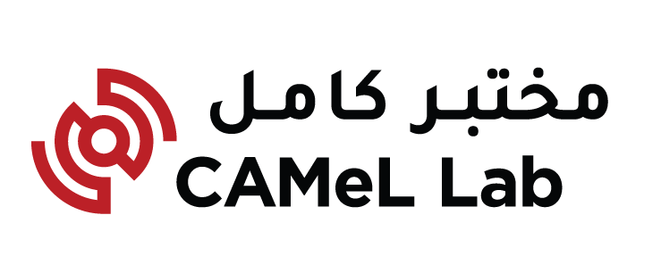

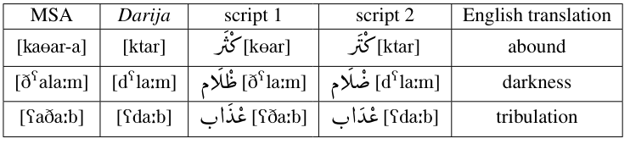
DiMorph
Postprocessing
Orthographic variation
Phonological simplification: This refers to the process whereby a language alters its sound system, resulting in the reduction or elimination of certain phonetic features.
24
Notes:
For orthographic variation, we adhere to the CODA standard (Conventional Orthography for Dialectal Arabic), as provided by Camel Lab. This ensures that our annotated corpus follows a universal norm and is understandable to others.
Throughout our research, we have encountered various cases where this standard has been applied effectively
The first case is as follows:
As shown in the table

Slide 30
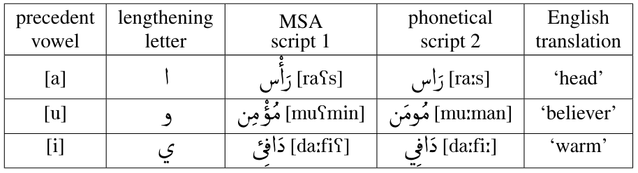
DiMorph
Postprocessing
Orthographic variation
Strict spelling conventions: include the representation of the glottal stop, known as the hamza.
25
Notes:
And for the second case, we encounter strict spelling conventions governed by the rules of HAMZA
The following table presents some examples

Slide 31
DiMorph
Postprocessing
Manual correction
The spelling errors: were identified as 'Not Found' during analysis and subsequently they were corrected by the annotators.
For example:
تدحك /tadɦak/ is corrected in تضحك /tadˁɦak/ `she laughs’.
عندومشاكيل /ʕanduːmaʃaːkiːl/ is corrected in عندو مشاكيل / ʕanduː maʃaːkiːl / `he has a problem’.
26
Notes:
Since our data is sourced from social media, we manually corrected some misspellings identified as 'Not Found' during analysis.
The first type of error involved incorrect spelling of a letter.
The second example highlighted issues with spacing between two tokens.

Slide 32
Results discussion
Size of the corpus is: 91.592 tokens
27
Notes:
The preprocessing phase addresses spelling variations, elongations, and script-mixing, while also tagging numbers and non-Arabic characters.
This meticulous preparation enhances subsequent analyses, achieving a recognition rate of 91.17%.

Slide 33
Results discussion
Size of the corpus is: 91.592 tokens
28
Notes:
In the processing phase, words are transformed into basic forms and grammatically categorized using Darija-specific linguistic resources and rules. Postprocessing further refines the text, providing alternative solutions for unrecognized words and improving treatment of spelling variations. This phase adeptly handles linguistic phenomena like code-switching and code-mixing, achieving a recognition rate of 86.29%.

Slide 34
Results discussion
Size of the corpus is: 91.592 tokens
29
Notes:
Overall, the sequential progression through these phases reflects a deep understanding of the Moroccan dialect's nuances, leading to an impressive accuracy rate of 98.91%.
The 1 percent of tokens not found underscores the importance of continually updating and expanding linguistic resources to improve coverage and accuracy in language processing tasks.

Slide 35
Conclusion
The creation of a morphological analyzer customized to dialectal characteristics.
The construction of linguistic resources specifically for dialects.
The construction of corpus annotated and vocalized.
30
Notes:
We presented an in-progress work aimed at:

Slide 36
Perspectives
Enrich the Moroccan DiMorph linguistic resources.
Apply deep learning strategies to annotate the Moroccan corpus.
31
Notes:
For future works, we plan to:

Slide 37
Thank you for your attention
Nadia khlif nadia.khlif@ilc.cnr.it
Giulia Benotto giulia.benotto@ilc.cnr.it
Ouafae Nahli ouafae.nahli@ilc.cnr.it

